Slide 1
Intro to Machine Learning

Slide 2
Types of learning
Machine Learning is divided into several subfields, based on:
Learning: supervised, unsupervised or something in between – reinforcement or semi-supervised
Learner: actively asking for examples or passively getting them
Teacher: random or adversarial
Processing: online or offline/batch

Slide 3
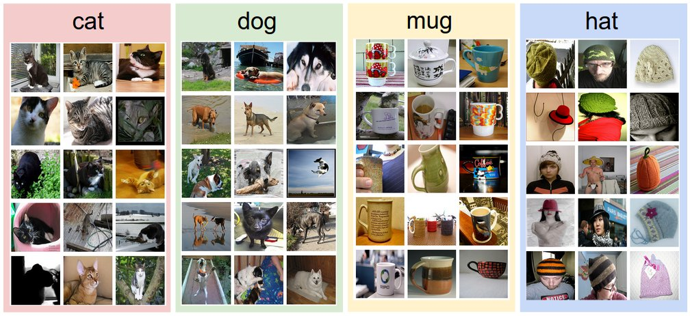
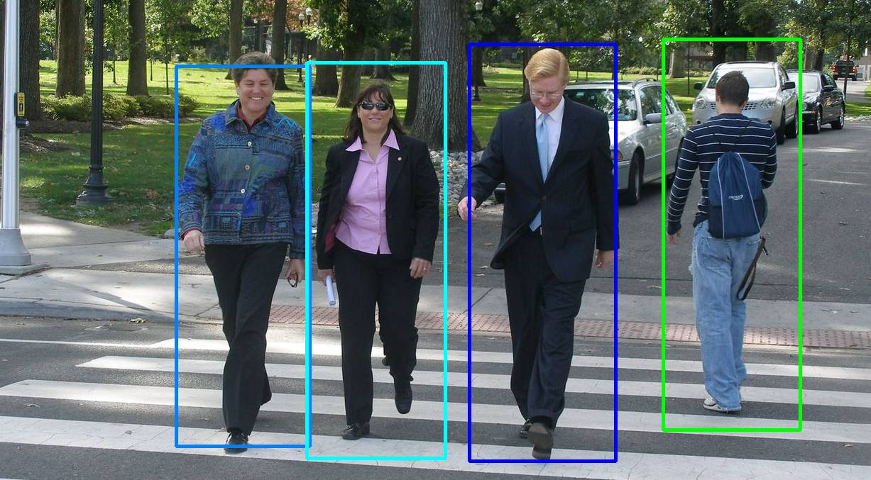
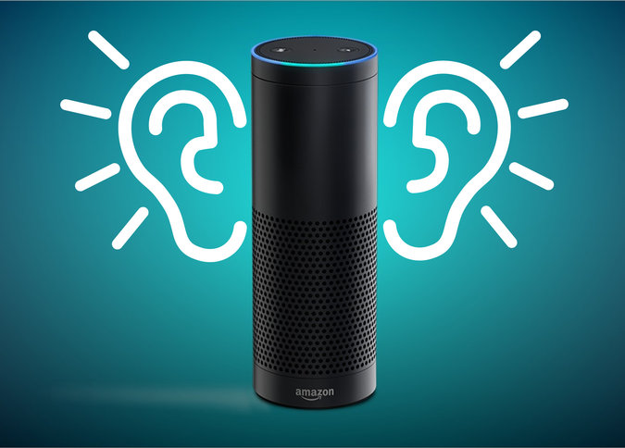
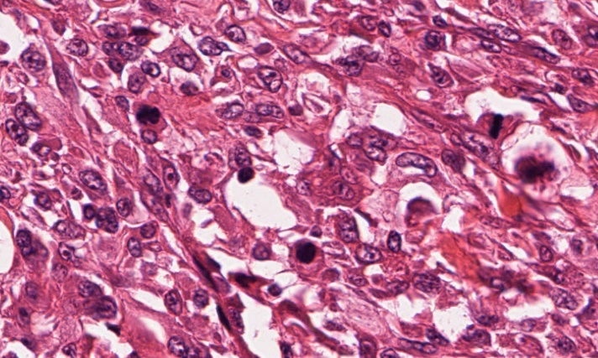

Supervised Learning

Slide 4
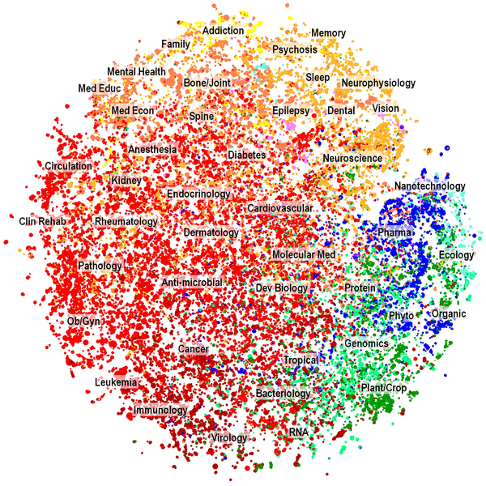
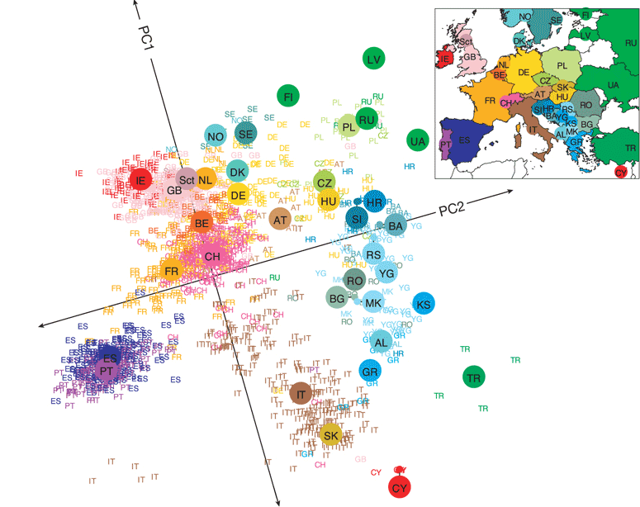
Unsupervised Learning

Slide 5
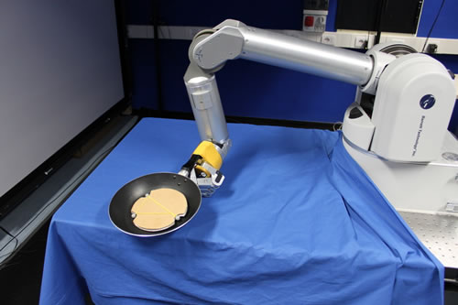
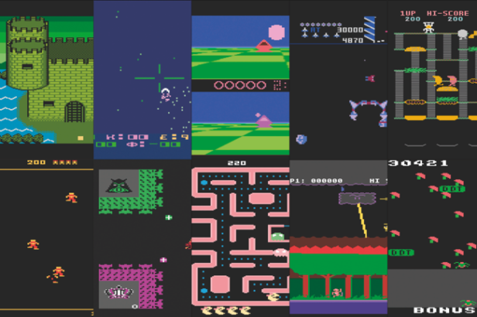
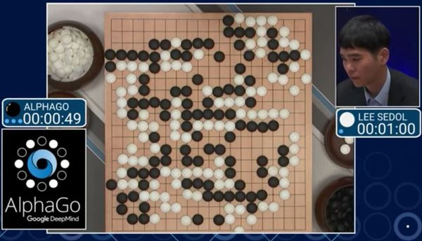


Reinforcement Learning
OpenAI: Universe

Slide 6
Introduction to Machine Learning
Classification – Predict answers to Yes/No questions
Regression – Predict real values
Clustering – Find patterns of similar objects
How to Evaluate Machine Learning Models

Slide 7
Classification

Slide 8
Machine Learning
Grew out of artificial intelligence within computer science. Teaches computers by example.
ML is arguably part of statistics.
Is this a chair?

Slide 9

Classification
We have a training set of observations (e.g., labeled images) and a test set that we use only for evaluation.
Training set
Test set
(not a chair)
(chair)
(not a chair)
(chair)
(not a chair)
(not a chair)
(not a chair)
(not a chair)
Notes:
.

Slide 10


Classification
Each observation is represented by a set of numbers (features).
Each pixel gets rgb values like [1.0,0.9,0.8]
Image becomes:
[1.0,0.9,0.8,0.1,0.5,…]
(Label is -1, it’s not a chair)

Slide 11
Classification
Each observation is represented by a set of numbers (features).
Manhole is represented as: [ 5 3 120 12 1 0 ….. ]
Inspected?
Vented cover?
Number of events last year
Number of electrical cables
Number of serious events last year
Number of pre-1930 electrical cables

Slide 12
Classification
Each observation is represented by a set of numbers (features).
Manhole is represented as: [ 5 3 120 12 1 0 ….. ]
Inspected?
Vented cover?
Number of events last year
Number of electrical cables
Number of serious events last year
Number of pre-1930 electrical cables
Training feature data is from 2014 and before
(Label is 1, it exploded in 2013)

Slide 13
Classification
Each observation is represented by a set of numbers (features).
Manhole is represented as: [ 5 3 120 12 1 0 ….. ]
Inspected?
Vented cover?
Number of events last year
Number of electrical cables
Number of serious events last year
Number of pre-1930 electrical cables
Training feature data is from 2014 and before
Label is 1 if it had an event in 2015

Slide 14
Classification
Each observation is represented by a set of numbers (features).
Manhole is represented as: [ 5 3 120 12 1 0 ….. ]
Inspected?
Vented cover?
Number of events last year
Number of electrical cables
Number of serious events last year
Number of pre-1930 electrical cables
Testing feature data is from 2015 and before
Predict what happen in 2016

Slide 15
Classification
Each observation is represented by a set of numbers (features).
Manhole is represented as: [ 5 3 120 12 1 0 ….. ] -1
[ 0 0 89 5 1 1 ….. ] 1
[ 1 0 20 0 0 1 ….. ] -1
: :
Features, called X
Labels, called Y
(Predictors, Covariates, Explanatory Variables, Independent Variables)

Slide 16
Classification
Formally, given training set (x_{i,}y_{i}) for i=1…n, we want to create a classification model f that can predict label y for a new x.

Slide 17
Classification
Formally, given training set (x_{i,}y_{i}) for i=1…n, we want to create a classification model f that can predict label y for a new x.
Manhole is represented as: [ 1925 15]
Year oldest cable installed
Number of events last year

Slide 18
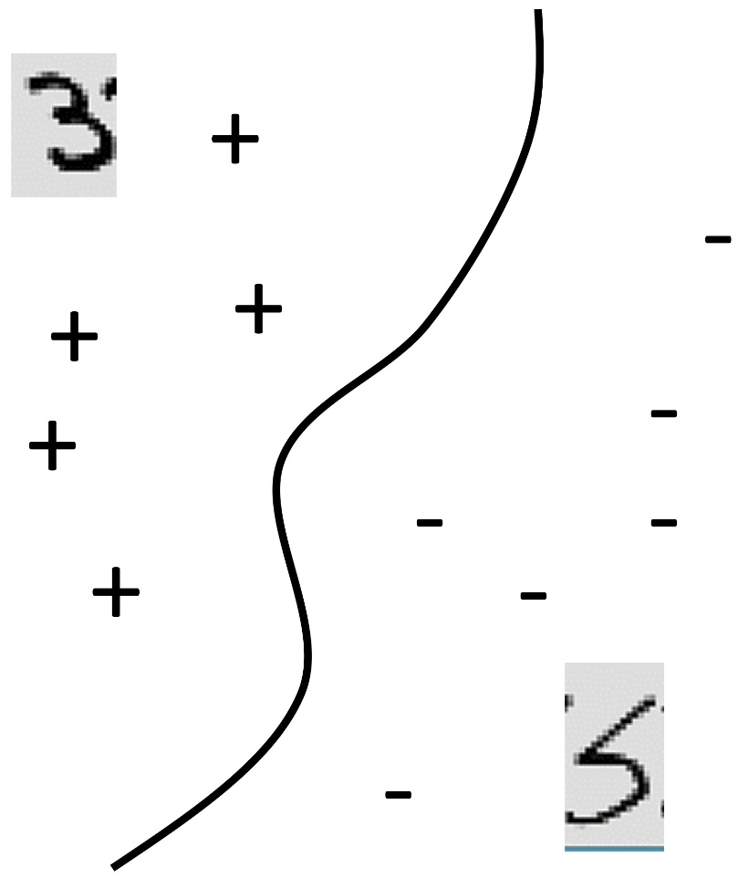
Classification
Formally, given training set (x_{i,}y_{i}) for i=1…n, we want to create a classification model f that can predict label y for a new x.
20
Manhole is represented as: [ 1925 15]
Events Last Year
Year oldest cable installed
Number of events last year
0
1925
Oldest cable
2015

Slide 19
Classification
Formally, given training set (x_{i,}y_{i}) for i=1…n, we want to create a classification model f that can predict label y for a new x.
20
f(x)>0
f(x)=0
f(x)<0
Manhole is represented as: [ 1925 15]
Events Last Year
Year oldest cable installed
Number of events last year
0
1925
Oldest cable
2015

Slide 20
Classification
Formally, given training set (x_{i,}y_{i}) for i=1…n, we want to create a classification model f that can predict label y for a new x.
20
f(x)>0
f(x)=0
f(x)<0
f(x) = function(Events Last Year, Oldest Cable)
Events Last Year
0
1925
Oldest cable
2015

Slide 21
Classification
Formally, given training set (x_{i,}y_{i}) for i=1…n, we want to create a classification model f that can predict label y for a new x.

Slide 22
Classification
Formally, given training set (x_{i,}y_{i}) for i=1…n, we want to create a classification model f that can predict label y for a new x.
The machine learning algorithm will create the function f.
The predicted value of y for a new x is sign(f(x)).

Slide 23
Classification
Yes/No questions – binary classification
automatic handwriting recognition, speech recognition, biometrics, document classification, spam detection, predicting credit default risk, detecting credit card fraud, predicting customer churn, predicting medical outcomes (strokes, side effects, etc.)

Slide 24
Classification
Common algorithms:
Logistic Regression (with L1 or L2 regularization)
Decision Trees / Classification Trees / CART / C4.5 / C5.0
AdaBoost (Boosted Decision Trees)
Support Vector Machines
Random Forests
Neural Networks
You never need to program these.

Slide 25
Regression

Slide 26
Regression
For predicting real-valued outcomes:
How many customers will arrive at our website next week?
How many tv’s will we sell next year?
Can we predict someone’s income from their click through information?

Slide 27
Regression
Each observation is represented by a set of numbers.
Income
A person is represented as: [ 5 3 120 12 1 0 ….. ] 84
[ 0 0 89 5 1 1 ….. ] 32
[ 1 0 20 0 0 1 ….. ] -10
: :
Features, called X
Labels, called Y

Slide 28
Regression
Each observation is represented by a set of numbers.
Income
A person is represented as: [ 5 ] 84
[ 0 ] 32
[ 1 ] -10
:
Single feature, called X
Labels, called Y

Slide 29
Regression
Formally, given training set (x_{i,}y_{i}) for i=1…n, we want to create a regression model f that can predict label y for a new x.
1,000K
f(x) = function(Number of Businessweek clicks)
f(x)
Income
0
2000
0
Number of Businessweek clicks

Slide 30
Regression
Formally, given training set (x_{i,}y_{i}) for i=1…n, we want to create a regression model f that can predict label y for a new x.
1,000K
f(x) = function(Number of Businessweek clicks)
f(x)
Income
(Overfitting?)
0
2000
0
Number of Businessweek clicks

Slide 31
Regression
Formally, given training set (x_{i,}y_{i}) for i=1…n, we want to create a regression model f that can predict label y for a new x.
1,000K
f(x) = function(Number of Businessweek clicks)
= 5K*Number of Businessweek clicks + 100K
f(x)
Income
(Underfitting?)
0
2000
0
Number of Businessweek clicks

Slide 32
Regression
Formally, given training set (x_{i,}y_{i}) for i=1…n, we want to create a regression model f that can predict label y for a new x.
1,000K
f(x) = function(Number of Businessweek clicks)
f(x)
Income
(Just right?)
We’ll talk more about this later
0
2000
0
Number of Businessweek clicks

Slide 33
Regression
Formally, given training set (x_{i,}y_{i}) for i=1…n, we want to create a regression model f that can predict label y for a new x.
Estimated income:
f(x) = function(Number of visits to upscale furniture websites, Number of Businessweek clicks, Number of distinct people emailed per day, Number of purchases of over 5K within the last month, Number of visits to airlines, etc.)
For instance,
f(x) = 3*Number of visits to upscale furniture websites
+10*Number of Businessweek clicks
+100*Number of distinct people emailed per day
+2*Number of purchases of over 5K within the last month
+10*Number of visits to airlines
But f(x) could be much more complicated

Slide 34
Regression Applications
Predict monetary amounts
Predict consumption or demand for products/energy

Slide 35
Supervised Learning
“Supervised” means that the training data has ground truth labels to learn from. Classification and Regression are supervised learning problems.
(Supervised) classification often has +1 or -1 labels.
(Supervised) regression has numerical labels.
Supervised learning algorithms are much easier to evaluate than unsupervised ones.
Notes:
There are lots of other supervised problems.

Slide 36



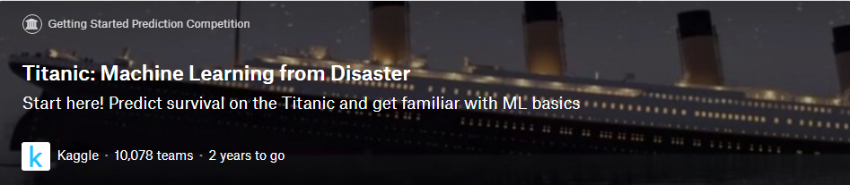
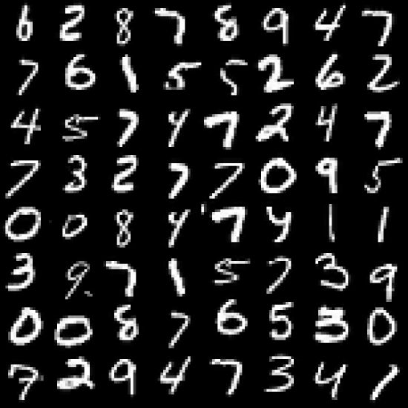


How do I start?
Digit Recognizer
Learn machine learning fundamentals with the famous MNIST data
Kaggle 1,827 teams 2 years to go

Slide 37
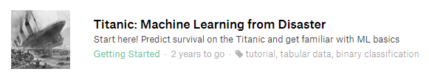
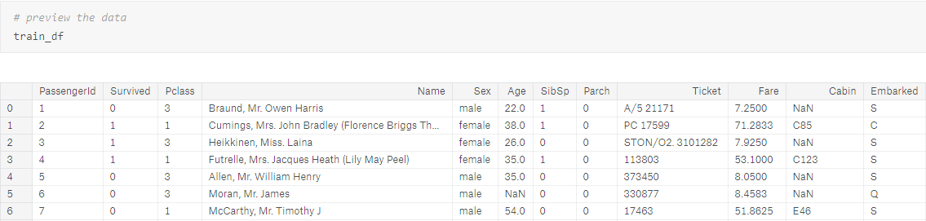
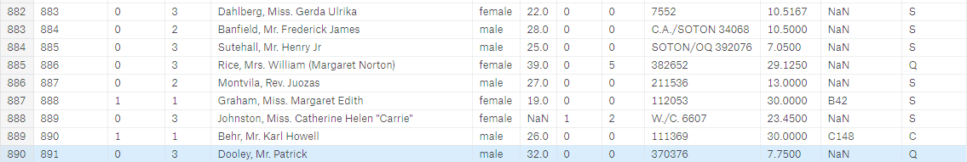
The sinking of the RMS Titanic is one of the most infamous shipwrecks in history. On April 15, 1912, during her maiden voyage, the Titanic sank after colliding with an iceberg, killing 1502 out of 2224 passengers and crew.

Slide 38
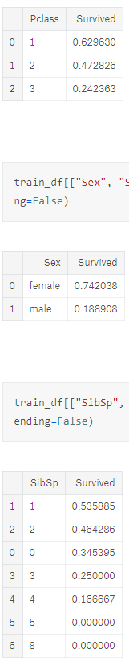
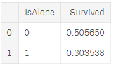
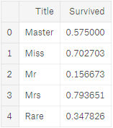
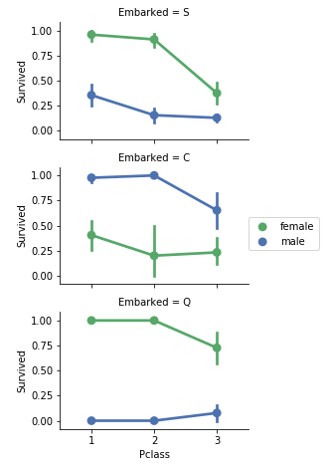
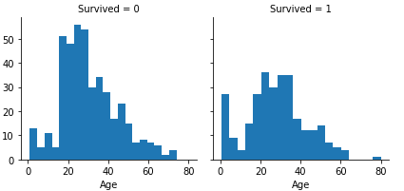

Slide 39
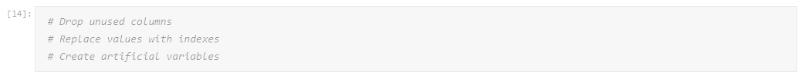
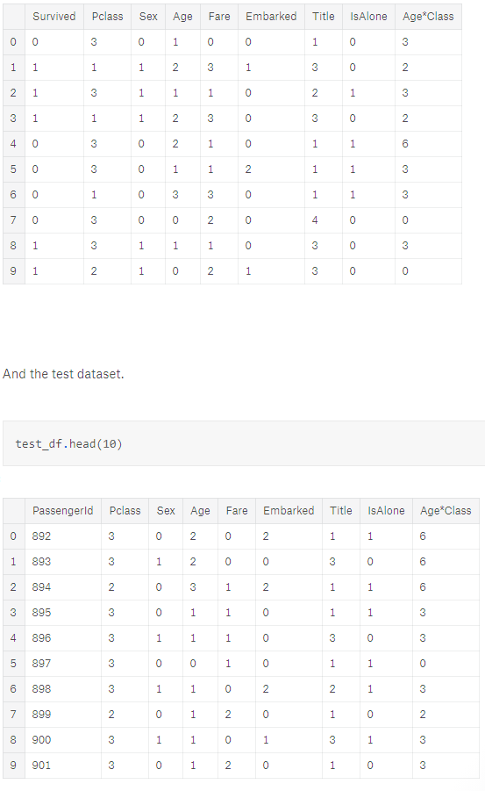

Slide 40
